Slide 1
Net Open Finder
Group 6
李瓖芸、周昀、吳宜凡

Slide 2
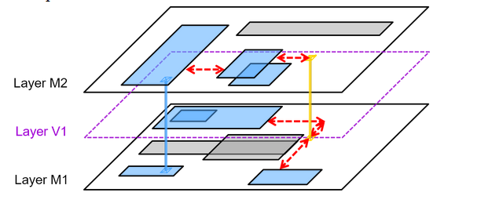
Goal
Connect all Shapes and Vias into one set with the minimum cost of the connections.

Slide 3
Main problems
* Finding shortest path for two distinguish points with or without obstacles between.
* Check for disjoint sets.
* Determine the closest point pair between two disjoint set.
* Avoid duplicated connection.
* Simplify the three-dimensional problem.

Slide 4
Others’ solution
Construct an MST (minimum spanning tree) connecting all the terminals of a complete weighted graph.
Manhattan Distance
Obstacle Penalty

Slide 5
Others’ solution
Partition MST into subtrees and merge with spanning graph using an ant-colony optimisation based algorithm.

Slide 6
Others’ solution
Perform rectilinearisation and refinement on OAMST to find the OARMST (obstacle avoiding rectilinear minimum spanning tree).

Slide 7
Others’ solution
Multilayer OARMST 3D reduction by projecting points from neighbouring layers to construct visibility graph.

Slide 8
Our solution
For each layer, sort all the shapes on x/y direction and check for all the overlapping, thus find all the trivial connections.

Slide 9
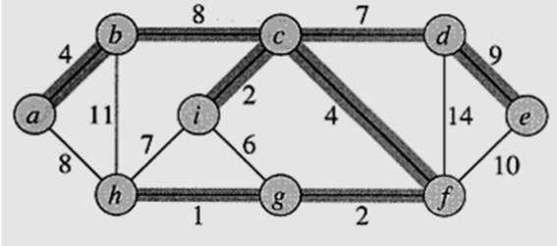
Our solution
Build a graph with nodes representing all the shapes and edges representing all the trvial connections. Then build a minimum spanning tree to find the necessary edges.

Slide 10
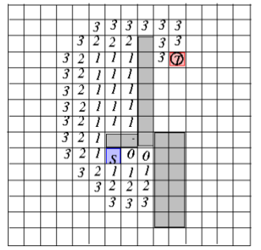
Our solution
For the remained disjoint set, use Hadlock’s Algorithm to find the shortest path for the chosen point pairs.

Slide 11
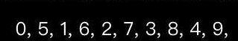
Our solution
Use OpenMP library to perform parallel for loop. This method is effective for this problem can be easily paralleled.

Slide 12
Complexity
N: number of shapes on each layer
O: number of obstacles
E: number of edges (all trivial connection) (usually an order larger than the number of nodes)
X,Y: distance between two points

Slide 13
Complexity
Trivial connection scanning: O(N^2)
Minimum spanning tree: O(E lgE)
Line adding: Θ(O)
Hadlock’s shortest path: Θ(X*Y)

Slide 14
Improvement
* Optimize through Vias
* Iterately scanning for tivial connection

Slide 15
Result
Benchmark/case1
#Shape=1503, #Obstacle=414
Layer1: E=7300, V=550, one MST
Layer2: E=2723, V=241, one MST
Layer3: E=9951, V=712, one MST
#Shape not in Graph=0
Benchmark/case2
#Shape=4518, #Obstacle=4773
Layer1: E=10589, V=767, one MST
Layer2: E=11082, V=929, one MST
Layer3: E=11831, V=917, one MST
Layer4: E=12693, V=1019, one MST
Layer5: E=11122, V=875, one MST
#Shape not in Graph=11

